Slide 1


On Intermittent Turbulence Heating of the Solar Wind
- Differences between Tangential and Rotational Discontinuities
Wang, X.¹, Tu, C. Y.^{1,3}, He, J. S.¹, Marsch, E.², Wang, L. H.¹
June, 2013
1 School of Earth and Space Sciences, Peking University, 100871 Beijing, China
2 Division for Extraterrestrial Physics, Christian Albrechts University at Kiel,D-24118
Kiel, Germany
3 chuanyitu@pku.edu.cn

Slide 2
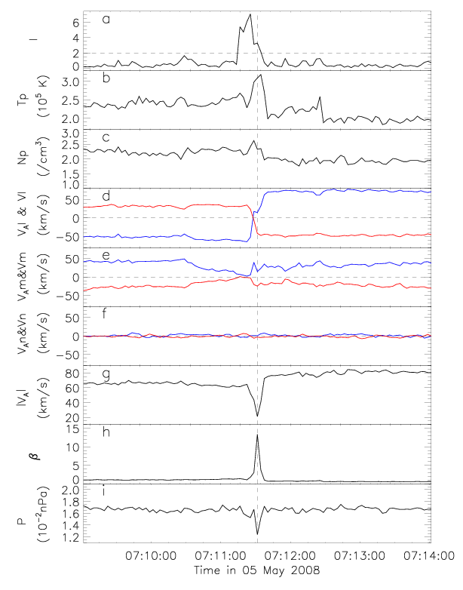
Case Study - 1
An Intermittent Structure Identified as Tangential Discontinuity
Observations from WIND MFI and 3DP
a.
b. an enhancement of ~40% in Tp
c. an enhancement of ~25% in Np
d. large jump in Bl and Vl
f. Bn ≈ 0
g. a jump of 25% and a dip of 60%
The tangential discontinuity (TD) has strong heating effect on the local wind plasma.

Slide 3
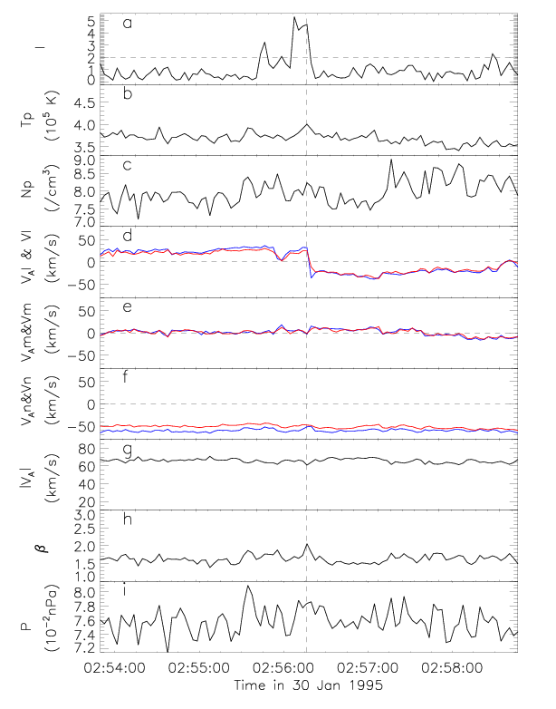
Case Study - 2
An Intermittent Structure Identified as Rotational Discontinuity
Observations from WIND MFI and 3DP
a.
b. slight enhancement of 5% in Tp
c. slight enhancement of Np
d. jump in Bl and Vl
f. |Bn|/|B| ≈ 0.7
g. a negligible jump in |B|
No convincing heating tendency are found for RDs.

Slide 4
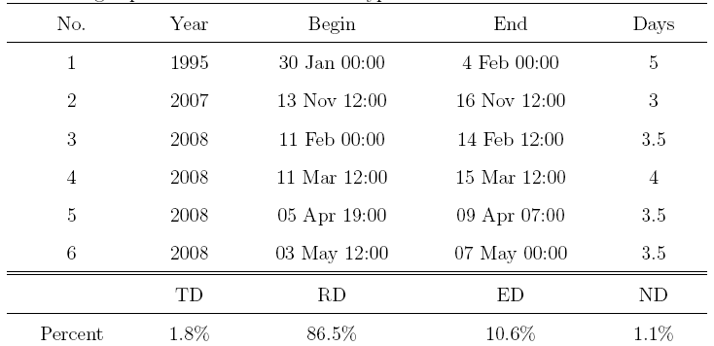
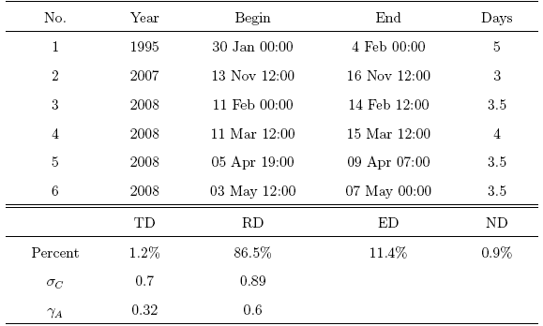
Statistical Study
Six high-speed solar wind streams observed by MFI (Lepping et al. 1995) and 3DP (Lin et al. 1995) on board WIND spacecraft are chosen for our study.
20,578 intermittent structures (~3% of the data set) are found by using the criteria I>2.
They are classified into four groups according to Smith (1973) and Tsurutani and Smith (1979).

Slide 5
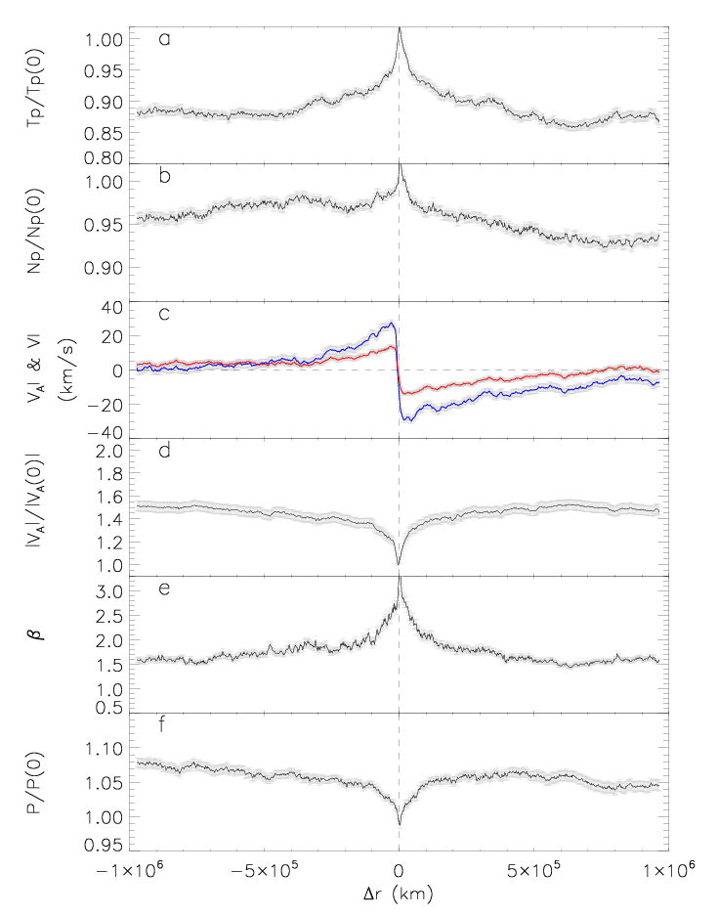
Superposed Epoch Analysis - 1
252 TD-type Intermittency
a. an enhancement of ~13% in Tp
b. an enhancement of ~5% in Np
c. large jump in Bl (blue) and Vl (red) (|Bn|<5 km/s)
d. a depression of 33% in |B|
The tangential discontinuity (TD) has strong heating effect on the local wind plasma.

Slide 6
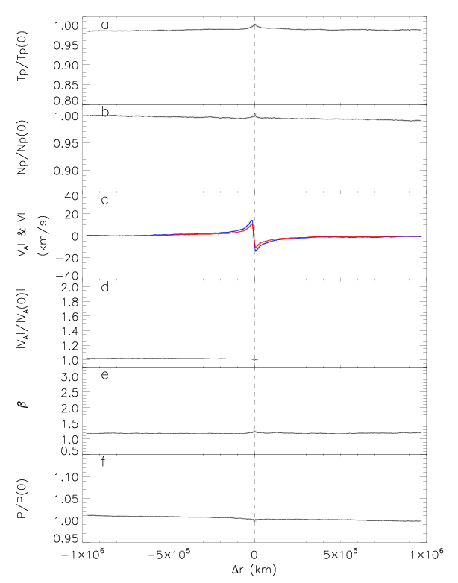
Superposed Epoch Analysis - 2
17,802 RD-type Intermittency
a. an enhancement of ~1% in Tp
b. an enhancement of ~0.6% in Np
c. jump in Bl (blue) and Vl (red)
|Bn|≈60km/s (not shown here)
d. a slight depression in |B|
No convincing heating tendency are found for RDs.

Slide 7
Conclusion
TDs are found to be associated with the local plasma heating (ΔT/T≈15%). But they are just 1.8% of the intermittency, and thus would not be a major source of the solar bulk wind heating.
For RDs, which take up 86.5% of the intermittency, no convincing evidence of local changes in the intrinsic thermal plasma parameters is found. Therefore, they are not the major source of solar wind heating, neither.
Wang et al., 2013, accepted by ApJL
Notes:
TDs are just local hot spots and not space filling.

Slide 8
On Intermittent Turbulence Heating of the Solar Wind
- Differences between Tangential and Rotational Discontinuities
(Appendix)
Wang, X.¹, Tu, C. Y.^{1,3}, He, J. S.¹, Marsch, E.², Wang, L. H.¹
June, 2013
1 School of Earth and Space Sciences, Peking University, 100871 Beijing, China
2 Division for Extraterrestrial Physics, Christian Albrechts University at Kiel,D-24118
Kiel, Germany
3 chuanyitu@pku.edu.cn

Slide 9
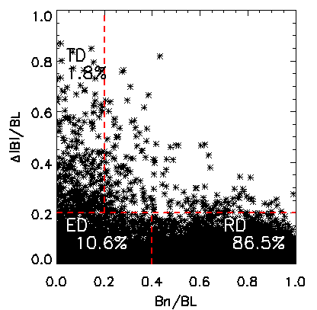
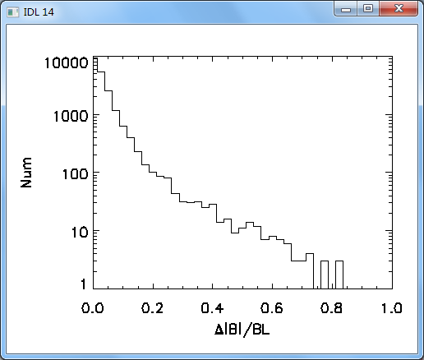
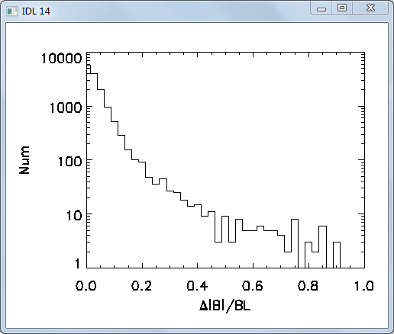
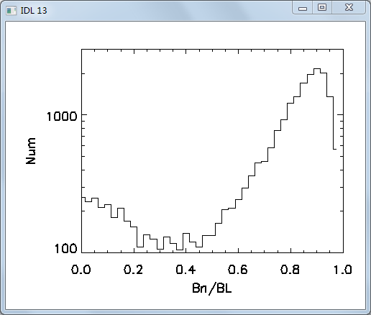
Identification of the Type of Discontinuity
——Tsurutani-Smith Criteria (Smith, 1973; Tsurutani and Smith (1979))
 | TD | RD
Num /20,578 | 1.8% | 86.5%
< σ_{C} > | 0.7 | 0.89
< γ_{A} > | 0.32 | 0.6
BL: the larger magnetic field magnitude on either side of discontinuity
Bn: the magnetic field component along the minimum variance direction
Δ|B|: the jump in field magnitude
Notes:
The Alfven ratio and \sigma_c averaged over periods with TCSs are 0.32 and 0.6 respectively. The Alfvenic correlations in the high speed wind get locally break. The magnetic energy is dominant. TCSs could originate from enhanced compressive slow mode waves, which has been found to be multi-scale embedded in the solar wind (Yao et al., 2011). That would involve normal ion Landau damping, which could be a likely mechanism for dissipation.

Slide 10
The Definition of Relative Increment of Tp
——ΔTp/Tp
ΔTp
Tp

Slide 11
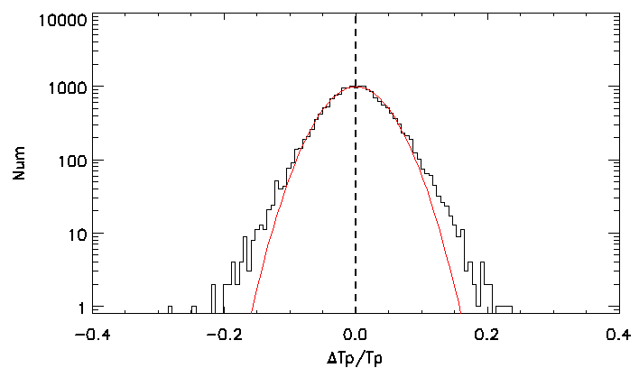
The Distribution of ΔTp/Tp
——RDs
<ΔTp/Tp> = 0.0±0.04
The RD-type intermittent structures have no convincing heating effect on the local solar wind plasma with <ΔTp/Tp> = 0.0 and the standard deviation σ=0.04.

Slide 12
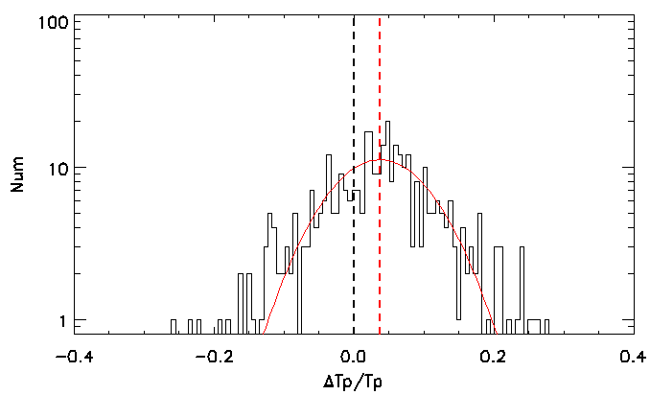
The Distribution of ΔTp/Tp
——TDs
<ΔTp/Tp> = 0.04±0.07
The heating effect of the TD-type intermittent structures is very clear with <ΔTp/Tp> = 0.04 and the standard deviation σ=0.07.

Slide 13
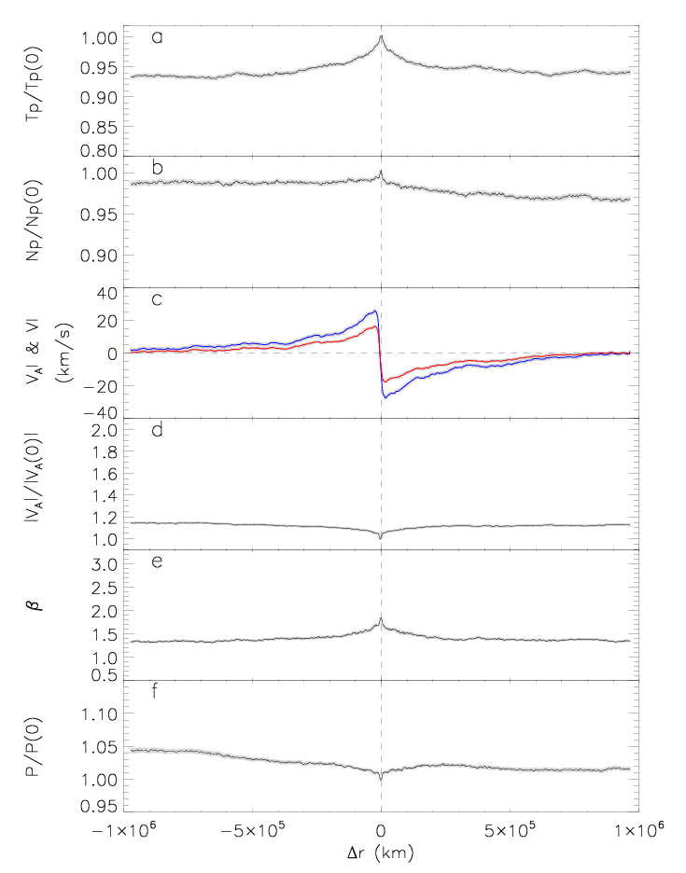
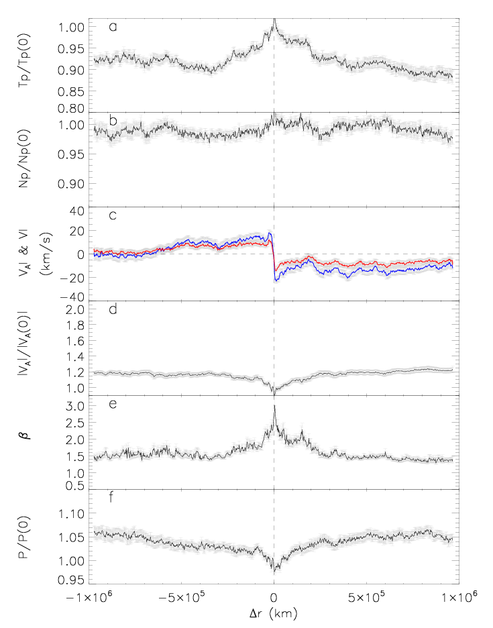
Superposed Epoch Analysis
EDs (10.6%)
NDs (1.1%)
ΔT/T ~ 7%
ΔT/T ~ 8%

Slide 14
Conclusion
TDs are found to be associated with the local plasma heating (ΔT/T≈15%). But they are just 1.8% of the intermittency, and thus would not be a major source of the solar bulk wind heating.
For RDs, which take up 86.5% of the intermittency, no convincing evidence of local changes in the intrinsic thermal plasma parameters is found. Therefore, they are not the major source of solar wind heating, neither.
Moreover, EDs and NDs have sight heating effect on the local solar wind plasma.
Wang et al., 2013, submitted to ApJL

Slide 15
A Pure Large-Amplitude Alfven Wave
Observed by WIND Spacecraft
Wang, X.¹, He, J. S.¹, Tu, C. Y.¹, Marsch, E.², Zhang, L¹
June, 2013
1 School of Earth and Space Sciences, Peking University, 100871 Beijing, China
2 Division for Extraterrestrial Physics, Christian Albrechts University at Kiel,D-24118
Kiel, Germany
Wang et al., 2012, ApJ, 746, 147

Slide 16
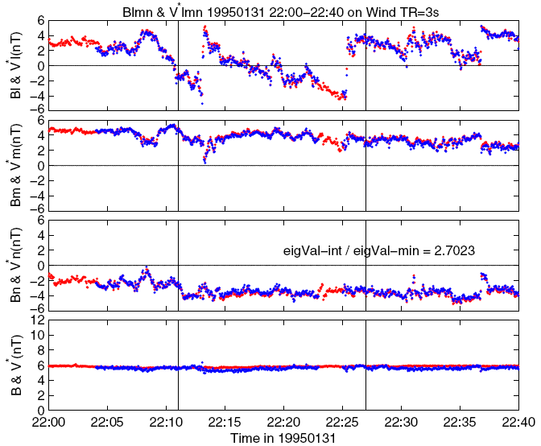
Large-amplitude Alfvenic Fluctuations
Large amplitude fluctuation in l direction
|ΔBl|/|B| ≈ 1
Correlation Coefficient
≈ 0.97
Constant |B| and |V|

Slide 17
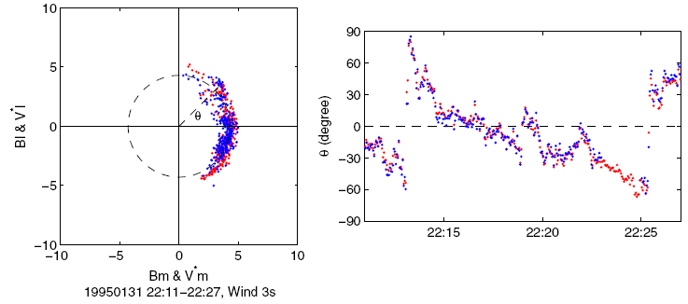
Arc-polarization of Large-amplitude Alfven wave
The hodograph of B (red) and V (blue)in the plane perpendicular to the n direction
Predicted by Barnes & Hollweg (1974) theoretically.

Slide 18
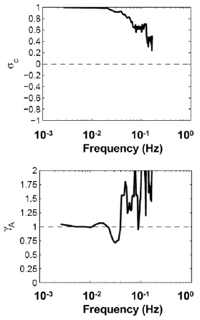
High σ_{C} and γ_{A}~1
Wang et al., 2012

Slide 19
Conclusion
We have presented, on the basis of WIND measurements of B and V, a clear case of pure LAW in the fast solar wind near 1AU. This case has the following characteristics:
  Large-amplitude fluctuations;
  constant |B|, Np and T;
  Fairly high correlation between B and v (σ_{C} ≈1, γ_{A}≈1);
  In the HT frame, B⊥ and V⊥ are both arc-polarized around an identical circle with centers at the origin.

