Slide 1
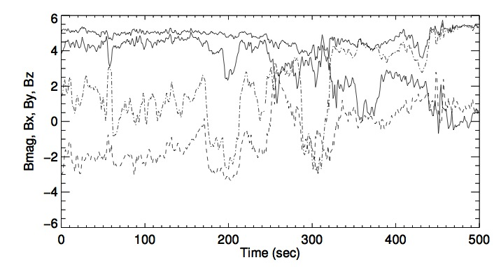
ACE MFI data, 500 sec on 1 Oct 2007

Slide 2
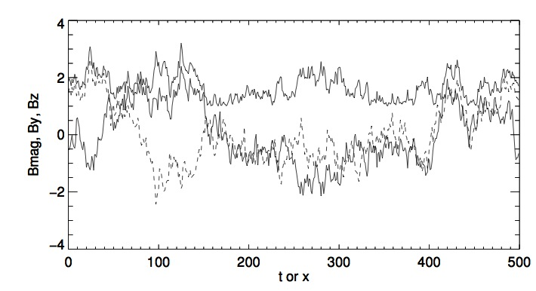
Randomly phased fluctuations perpendicular to a mean field

Slide 3
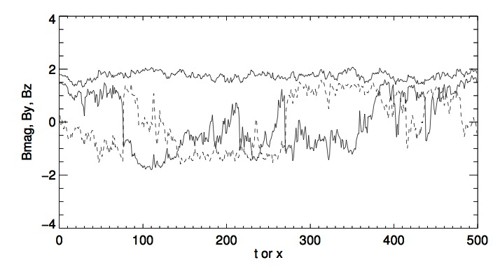
Perpendicular fluctuations with phases chosen to minimize |B| fluctuations

Slide 4
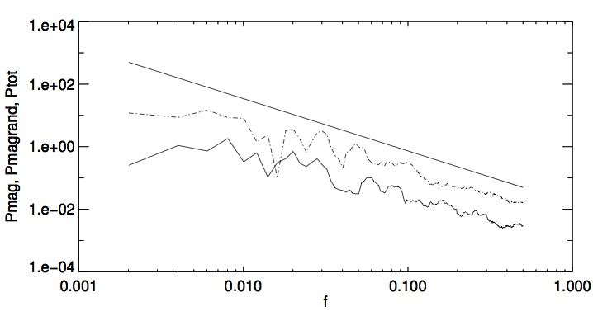
Power spectra of components and |B|, randomly phased (_._) and optimized (solid)

Slide 5
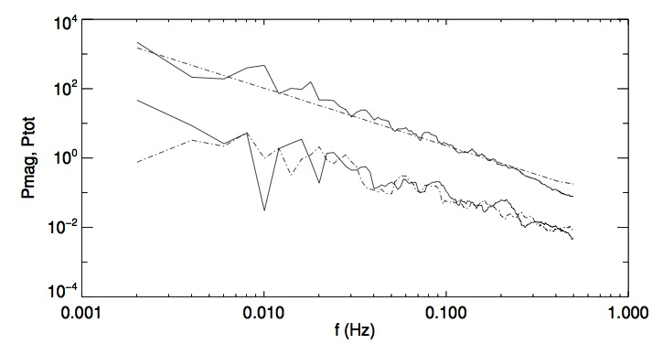
Spectra of ACE (solid) compared to optimized phases case. (Top: components, bottom magnitude)

