Slide 1
Correlation Length of Energy at the Base of Coronal Holes
Valentina Abramenko ¹
Gary Zank ²
Alexander Dosch ²
Vasyl Yurchyshyn ¹
1 - Big Bear solar Observatory of NJIT, CA
2 – CSPAR, Univ. of Alabama in Nuntsville, AL

Slide 2
Photospheric motions are immediately transferred into the chromosphere and corona

Slide 3
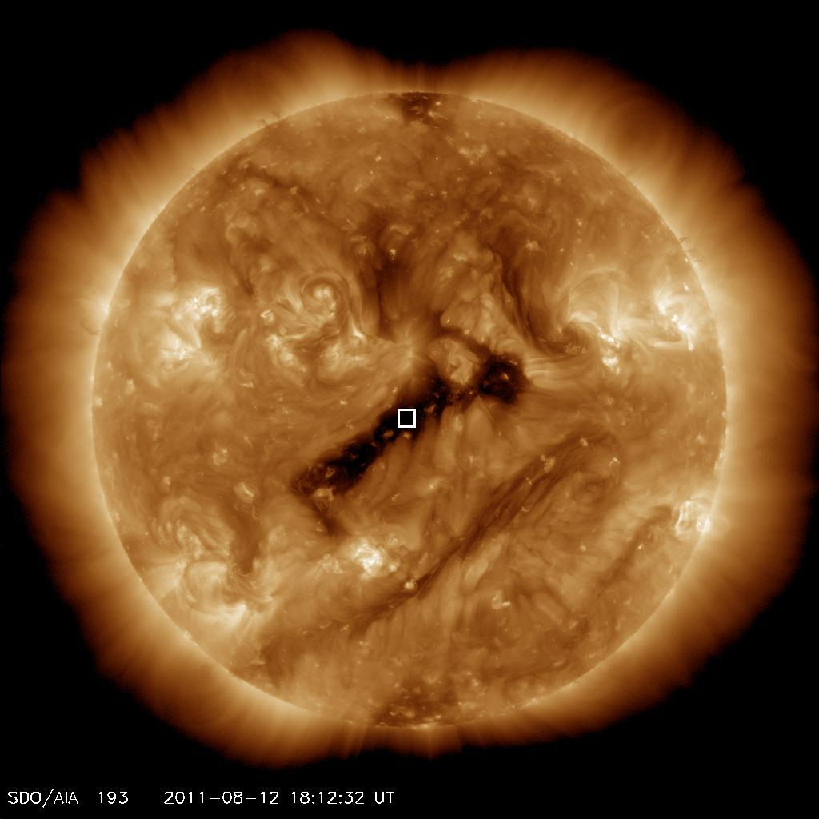
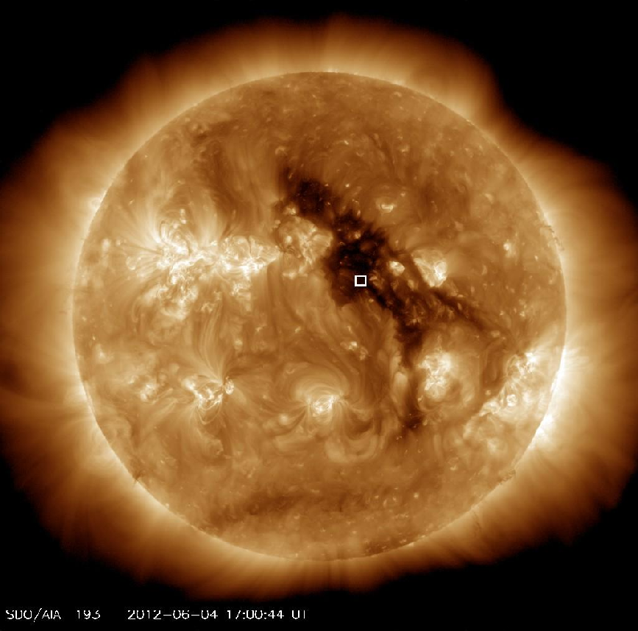
Magnetic and velocity fluctuations were analyzed in the photosphere inside two coronal holes

Slide 4
Notes:
Photospheric granulation images obtained with the New Solar Telescope at Big Bear Solar observatory of NJIT reveal dynamics of random motions continuously shifting footpoints of magnetic flux tubes and, hence, generating MHD waves.

Slide 5
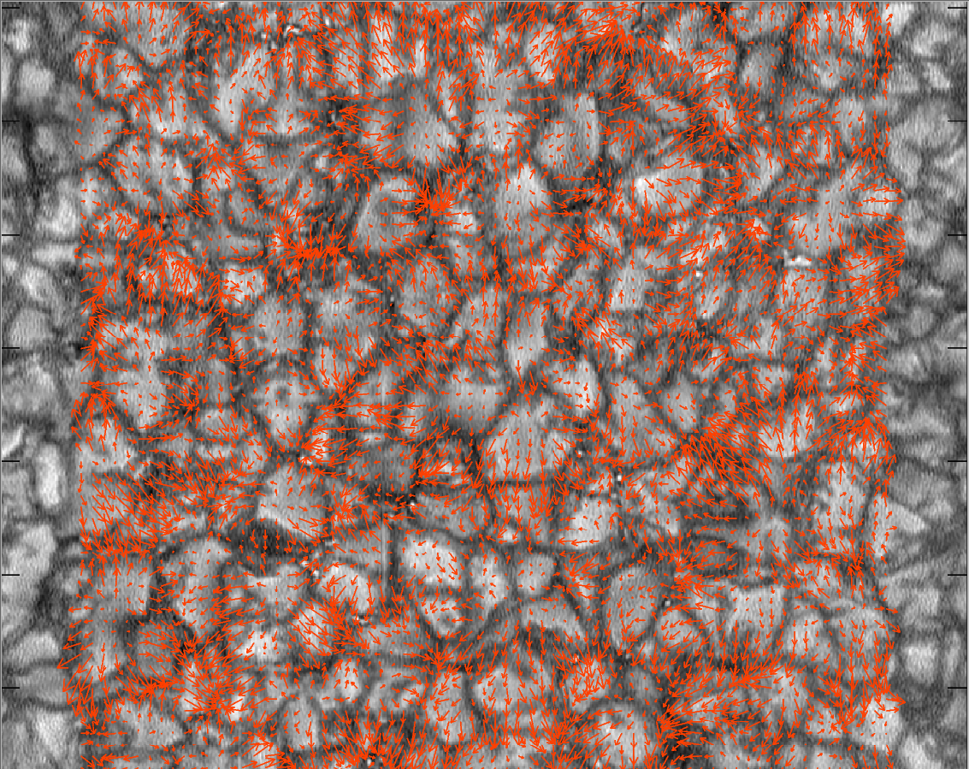
u_{x} , u_{y}
u²
Notes:
Comparing consecutive images, transverse velocities were determined using the Local Correlation Tracking (LCT) technique. The 2D structures of u^2 represent the energy-containing structures in the photosphere. Our goal is to determine the characteristic length scale of these structures.

Slide 6
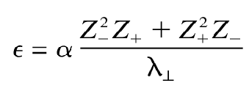
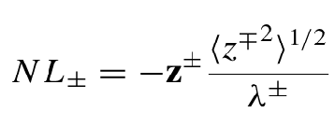
Correlation Function of u² :
Correlation function allows to estimate a characteristic length λ
of energy containing structures, which defines directly the
heating rate:
Matthaeus et al. 1999:
Zank et al. 2012:

Slide 7
Correlation Function:
Correlation function allows to estimate a characteristic length by different ways:
1.To determine the Batchelor integral scale:
2. From an exponential fit
to calculate the correlation length ζ
3. To calculate the e-folding scale L of the correlation function.

Slide 8
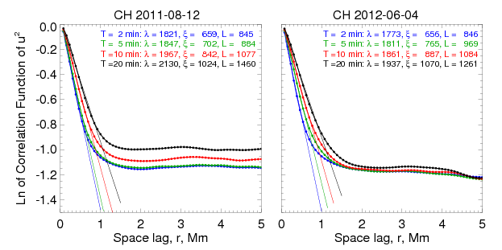
Calculated Correlation Functions
of u² structures

Slide 9
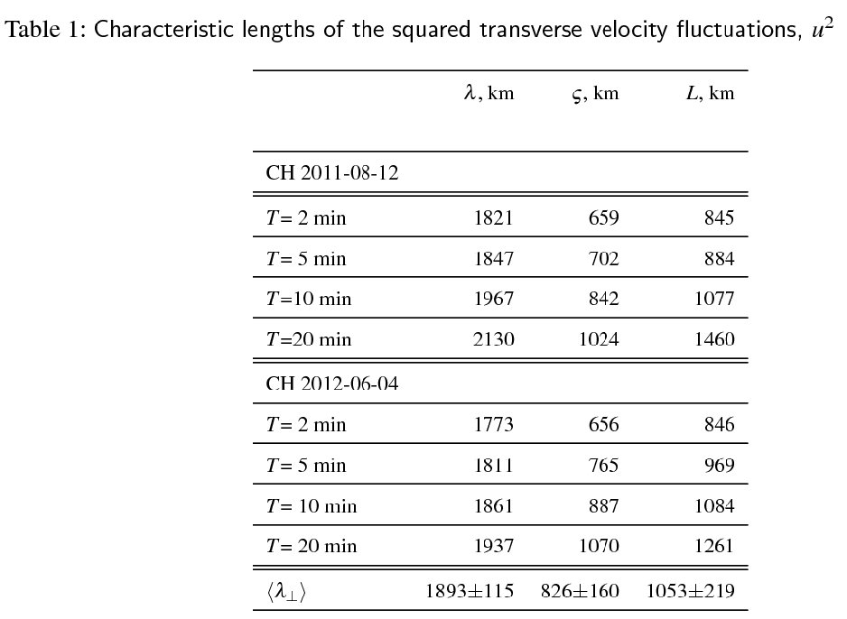

Slide 10
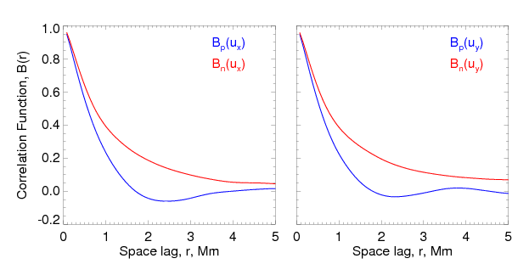
Parallel and Normal Correlation Functions
of u_{x} and u_{y} velocity components

Slide 11
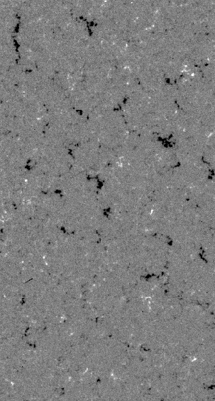
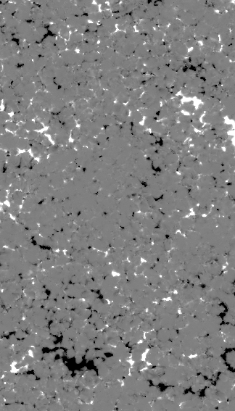
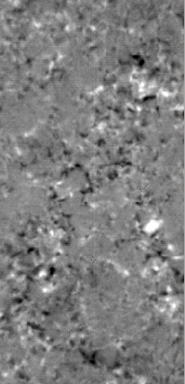
Magnetic Field in Coronal Holes
HMI (0.5”) 2011/08/12
SOT/SP (0.16”) 2007/03/10
NST (0.098”) 2012/06/02
16 Mm
120 Mm
36 Mm
Notes:
The better the telescope resolution, the more mixed polarity magnetic elements become visible. And the multi-fractal nature on small scales become better pronounced.

Slide 12
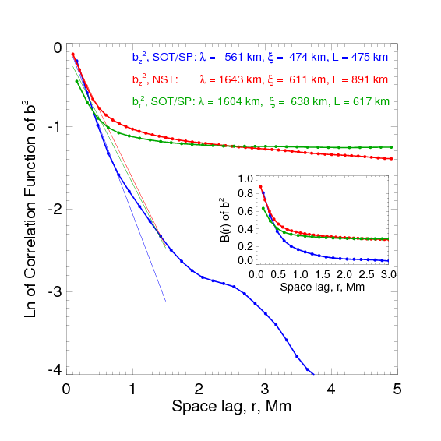
Correlation Functions from magnetic field fluctuations

Slide 13
Conclusions
The characteristic length scale of energy containing structures at the photosphere level seems to be of order of 1000 km (characteristic granule scale), but not 30 000 km (characteristic super-granular scale) as it was adopted in various SW models so far.
Bulk of photospheric dynamics is concentrated in inter-granular lanes.

Slide 14
Magnetic and Kinetic Power Specra at the Base of Coronal Holes
Valentina Abramenko
Big Bear solar Observatory of NJIT, CA

Slide 15
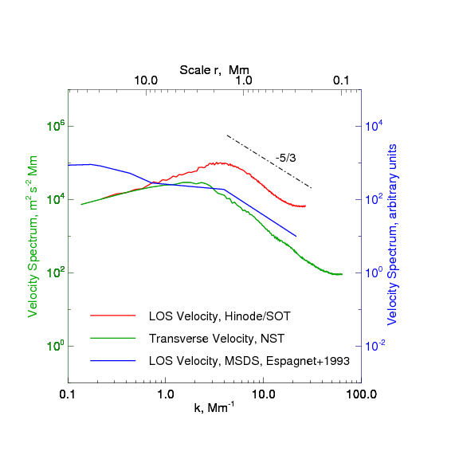
Kinetic and Magnetic Energy Spectra
Observed Velocity Spectra
Notes:
This are velocity spectra from observations.
Blue line – Peak du Midi observations with resolution of 0.8 arcsec (Espagnet et al. 1993 AA271).
Red – Doppler velocities from Hinode SOT in the line v1=6301A (2008 03 10, QS).
Green – transverse velocity from NST observations of the solar granulation in QS, pixel size 0.0375 arcsec and dif limit of 0.1 arcsec (2009 Jul 29 TiO , ref na Goode +2010).
All the spectra show a maximum at 1.5-2 Mm subsequent with a Kolmogorov-type decrease.
The dissipation scale (a break to the steeper slope) is not observed. Apparently, the viscous dissipation scale is very small and below the resolution limit of the modern telescopes.

Slide 16
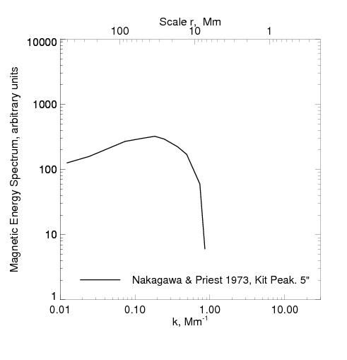
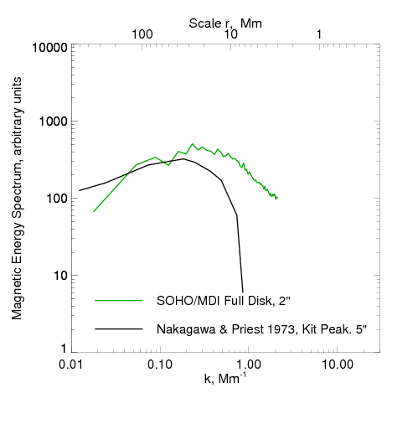
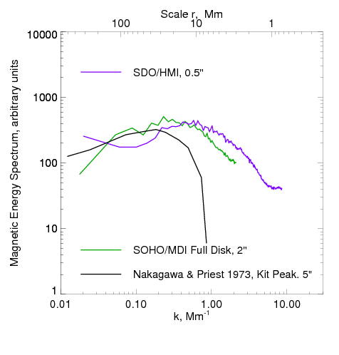
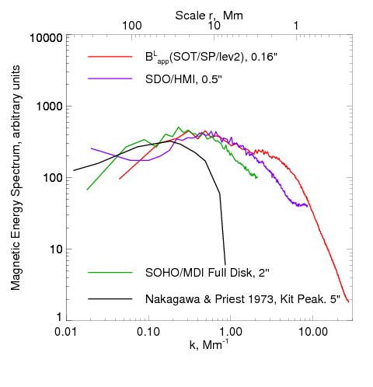
Kinetic and Magnetic Energy Spectra
Observed Magnetic Spectra
_{-1/3}
k^{-1/3}
XXV IUGG/IAGA, Melbourne, Australia
Notes:
What we have for the magnetic spectra?
Black line is the very old result, the power spectrum of the magnetic field in QS. Kit Peak data with 5 arcsec resolution were used by Nakagawa and Priest (1973,ApJ 179, 441). The spectrum saturates at scales of about 20 Mm.
Next, the MDI FD data (green) saturates at scales about 10 Mm. The steeper slope below 10 Mm might be an energy cascade signature, However, observations with higher resolution (purple line, HMI data) demonstrate an extension of the shallow magnetic spectra toward smaller scales, down to 4-5 Mm.
And observations with Hinode/SOT show that the magnetic spectrum extends with the same slope of about -1/3, down to 1.5 Mm scale.
The behavior essentially different from that we saw for the velocity spectra.
So, we may presume that further observations with better resolution might easily show the more extended shallow magnetic spectrum, which could follow this dashed line.

