Slide 1
Session A Wrap Up

Slide 2
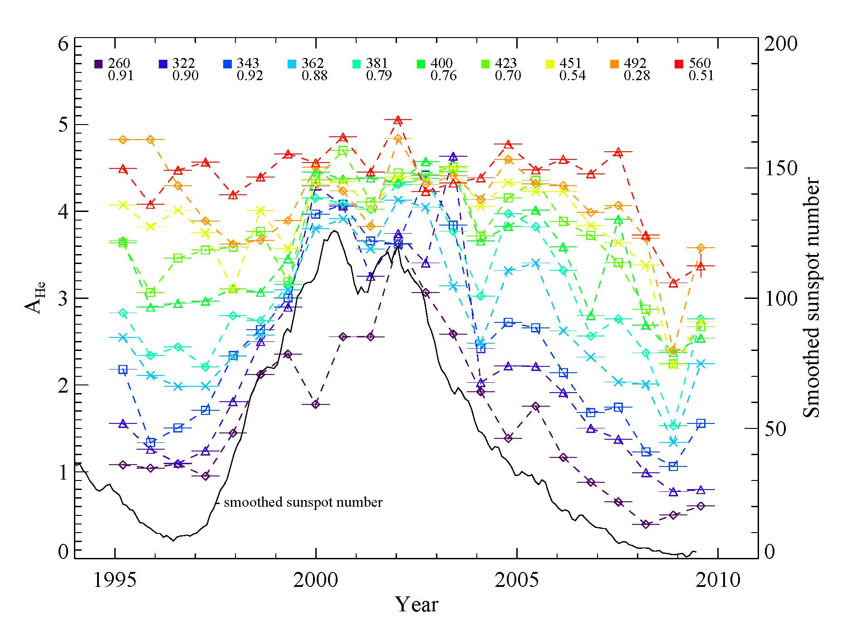
He Abundance
J. Kasper
Helium abundance variation over the solar cycle, latitude and with solar wind speed
Slow solar wind appears to be depleted in helium
Less speed ordering at solar maximum
6 month periodicity with heliographic latitude
Loss of He during past few years.
Do other species follow this trend?

Slide 3
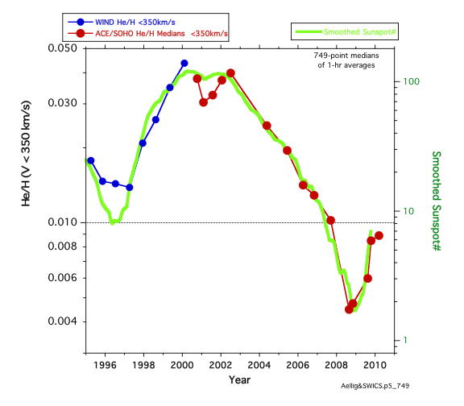
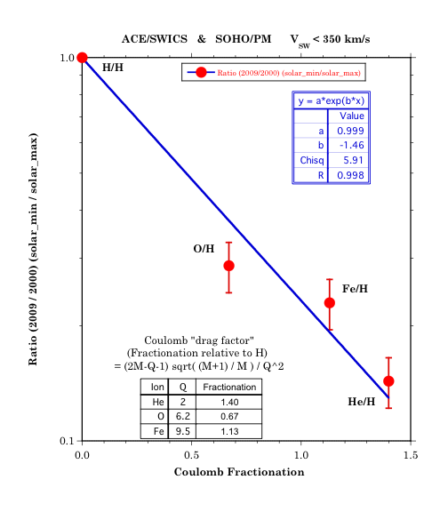
Abundance Variations
F. Ipavich
Sunspot number and helium density track remarkably close
Photospheric abundances reported in literature change over time
Ratios of solar maximum to solar minimum values of elemental abundances (X/H) do not show a mass or mass per charge preference.

Slide 4
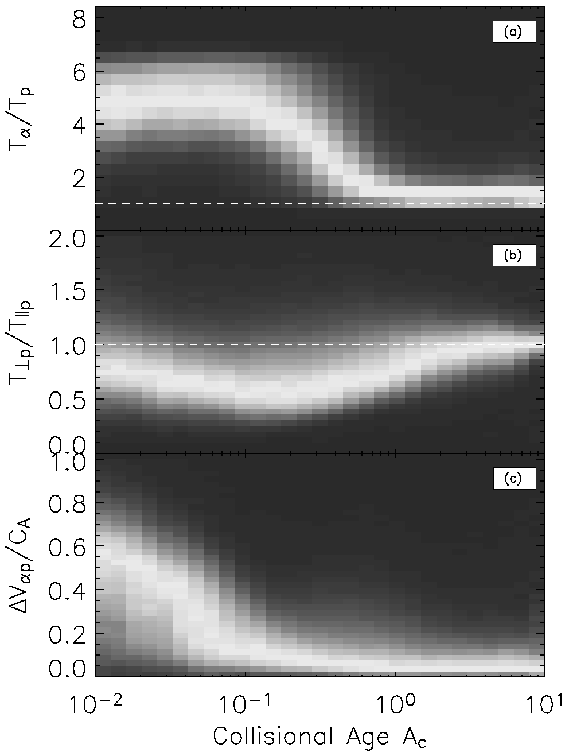
Collisional Age of Solar Wind
J. Kasper
Ordering of solar wind parameters by collisional age (kinetic temperatures of protons and alphas, differential flow)

Slide 5
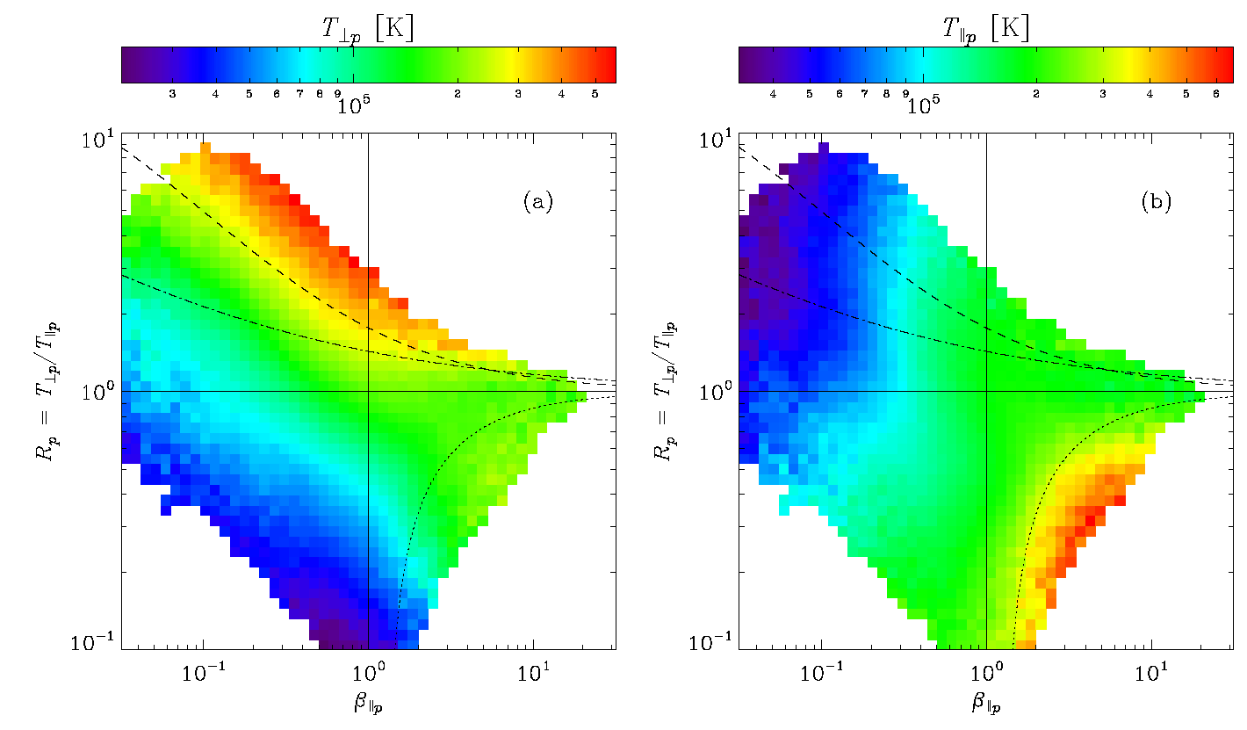
Heating of the Solar Wind
J. Kasper
Heating of ions is limited by the mirror instability vs. the cyclotron instability.
While heating perpendicular to the magnetic field is better understood, a parallel heating mechanism is needed.

Slide 6
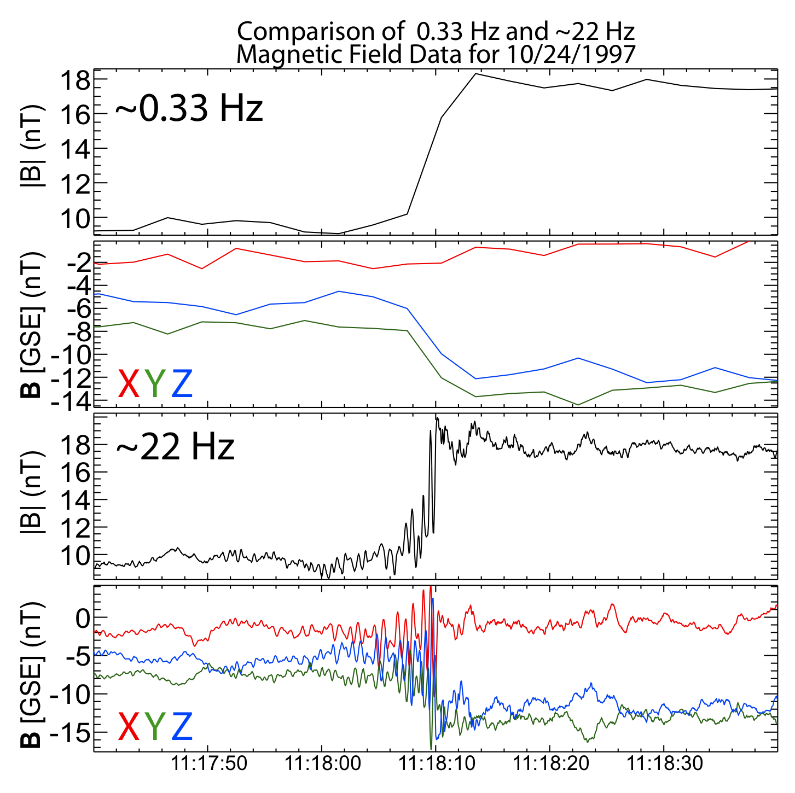
Wave Modes at IP Shocks
L. Wilson
High resolution data shows shocks actually have a lot of structure
lower hybrid waves with periods on the order of a second couple to whistler waves.
On higher scales, there are ion acoustic waves
Comparison of ACE and Wind electron distributions. (Gosling, Wilson)

Slide 7
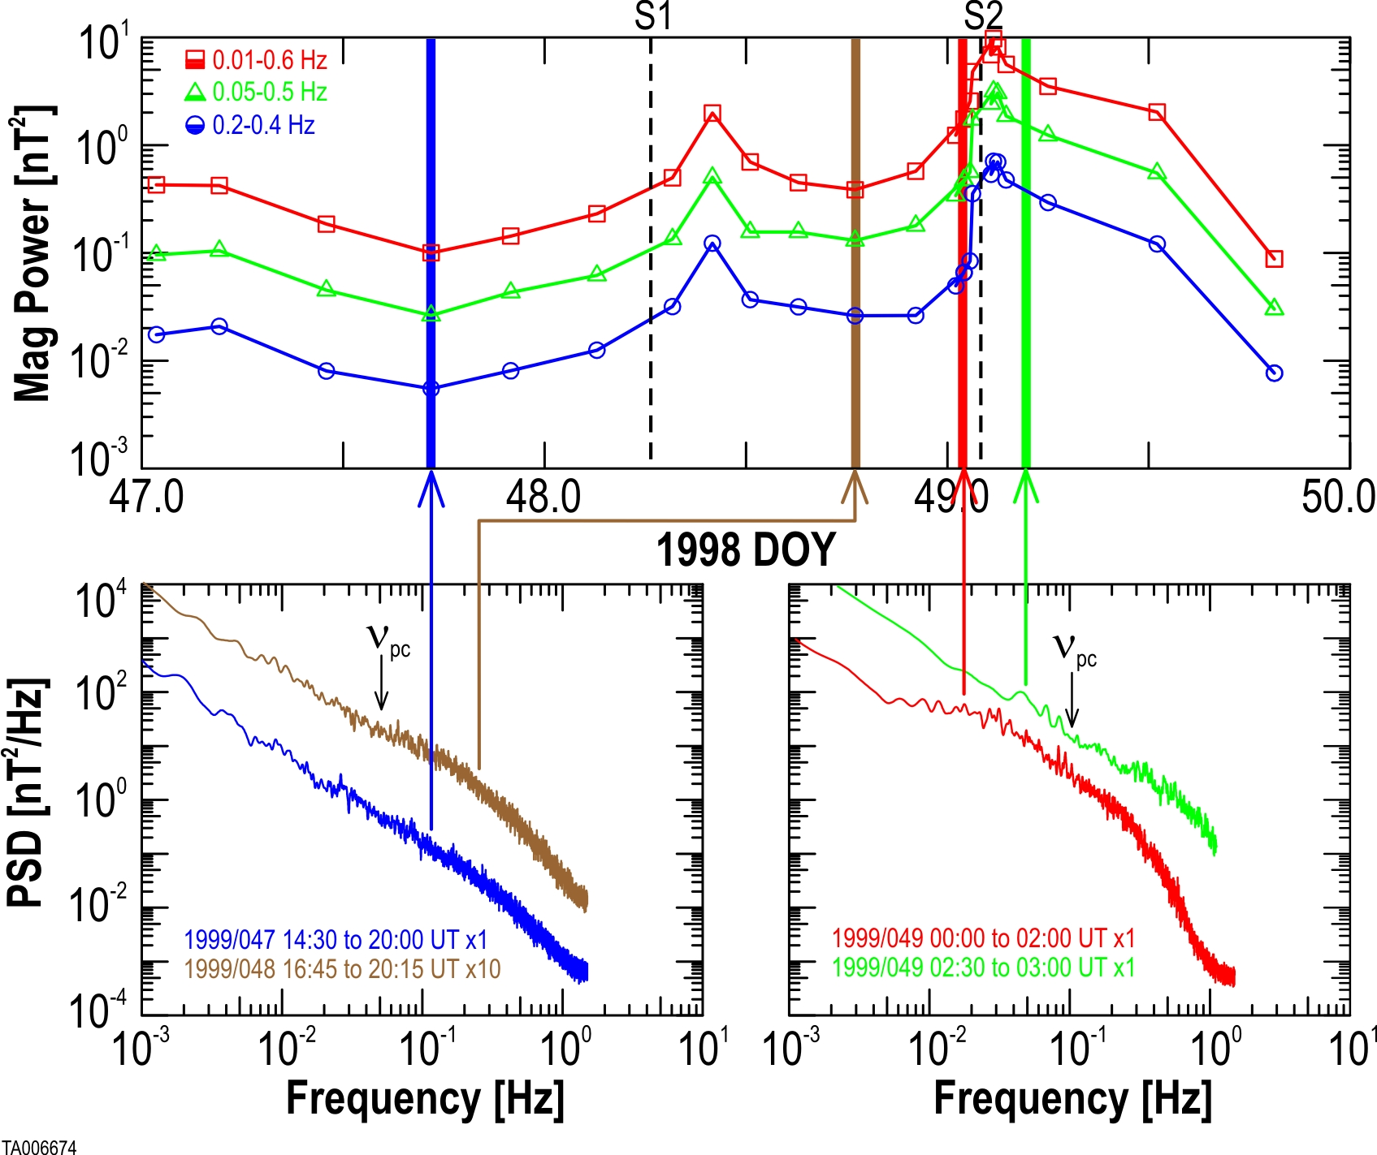
Acceleration of Particles at Shocks
M. Desai
Why are there so few upstream proton excited wave events?
What is the relationship between shock properties and the existence of upstream waves?
Add Wind data to current ACE study (Desai, Szabo)

Slide 8
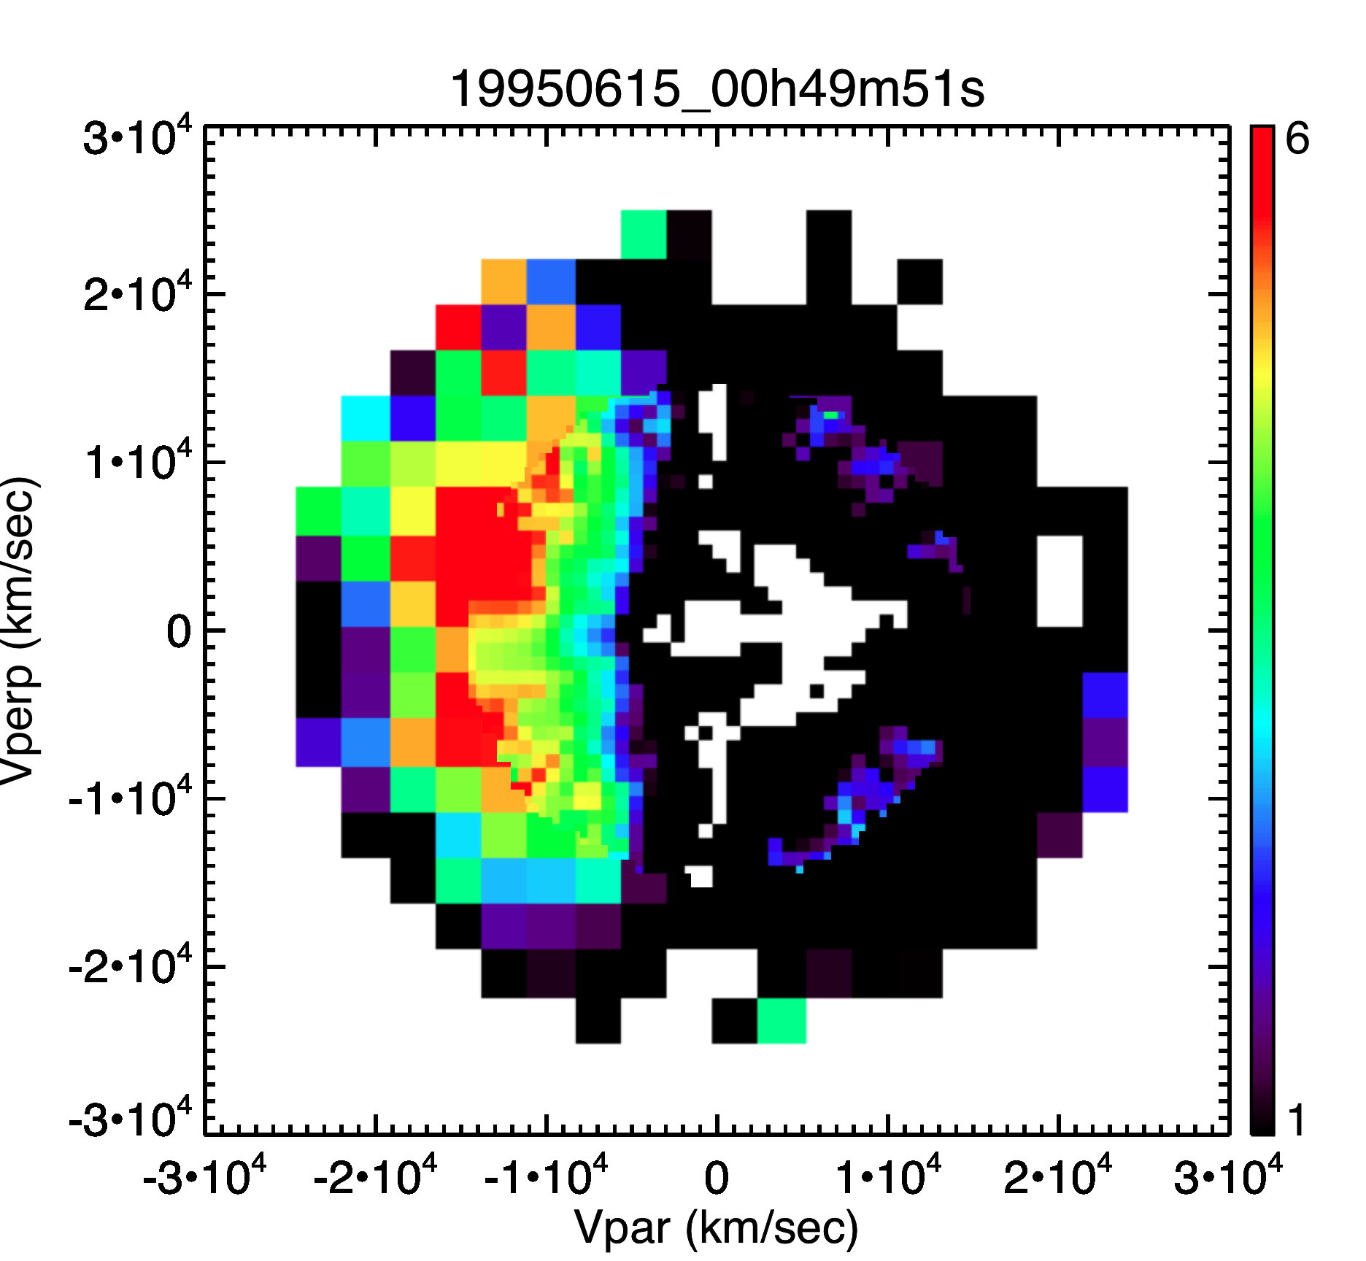
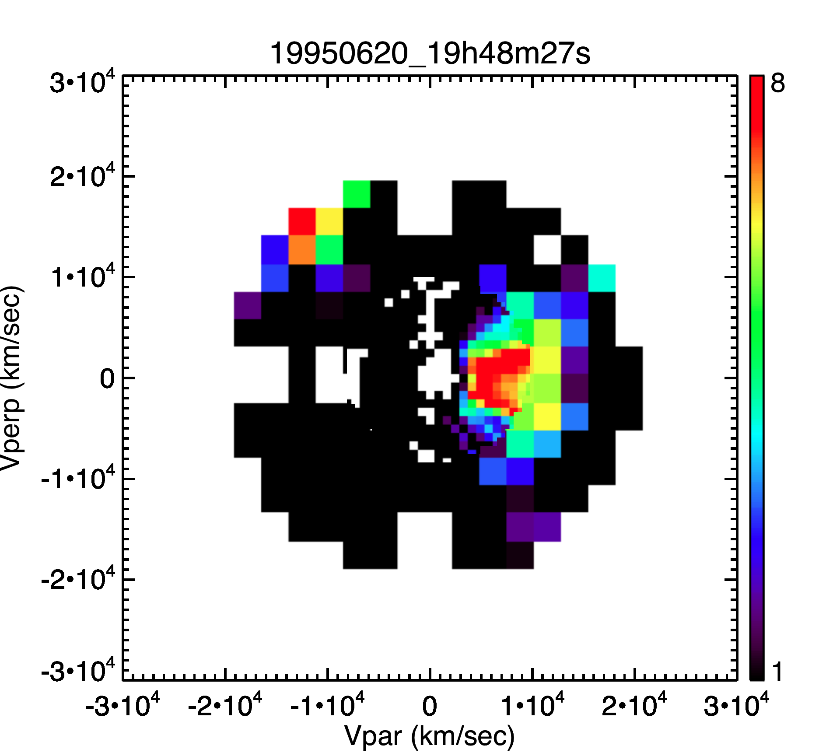
Electron Strahl
C. Salem
Fitted individually the core and halo component of electron distribution measured by Wind.
Subtracted core and halo from measured distribution to obtain strahl.
Variability in angular width of strahl. Why?
Will process much larger event base.

Slide 9
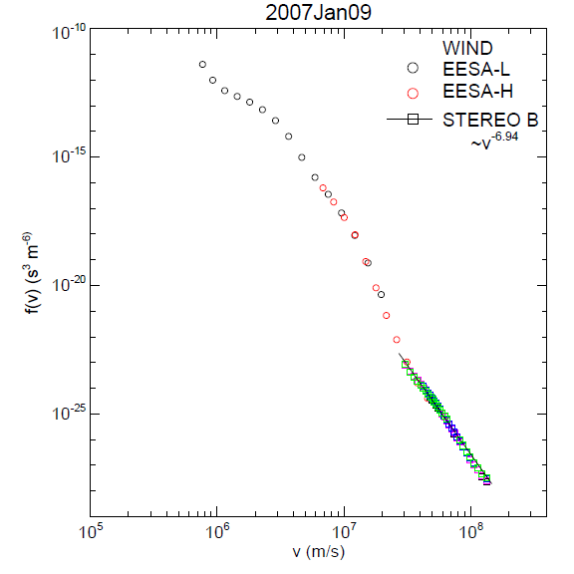
Electron Distribution
L. Wang
Electron velocity distribution function constructed using combined Wind and STEREO data.
Super-halo electrons rarely shows a v⁻⁵ spectrum. Why? Equilibrium between electrons and Langmuir waves?

Slide 10
Electron Reflected from Bow Shock
M. Pulupa
Energetic reflected electrons observed upstream of the Earth’s bow shock.
What happens to fast Fermi theory when the electrons have energies of tens of keV and therefore are nonadiabatic?
What are the effects of solar wind density fluctuations?
How can we measure shock parameters when we are tens of Re or more upstream?

